Slide 1
VRINDA STORE DATA ANALYSIS
Sakshi Sharad Gunjal

Slide 2
INTRODUCTION
This is a publicly available Data.
The Dataset which I’m using here to make this project is vrinda store.

Slide 3

OBJECTIVE
Vrinda store wants to create an annual sales report for 2022. so that vrinda can understand their customers and grow more sales in 2023.

Slide 4
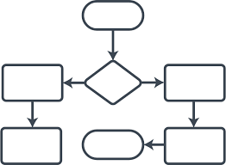
WORK FLOW OF PROJECT
Data Cleaning
Data Processing
Data Analysis
Data Visualization
Report
Insights
WORK FLOW
DATA PROCESSING
DATA CLEANING
DATA ANALYSIS
INSIGHTS
REPORT
DATA VISUALIZATION

Slide 5
SAMPLE QUESTIONS
Compare the sales and orders using single chart
Which month got the highest sales and orders?
Who purchase more men or women in 2022?
What are different order status in2022?
List top 10 states contributing to the sales?
Relation between age and gender based on number of orders
Which channel is contributing to maximum sales?
Highest selling category?, etc.

Slide 6
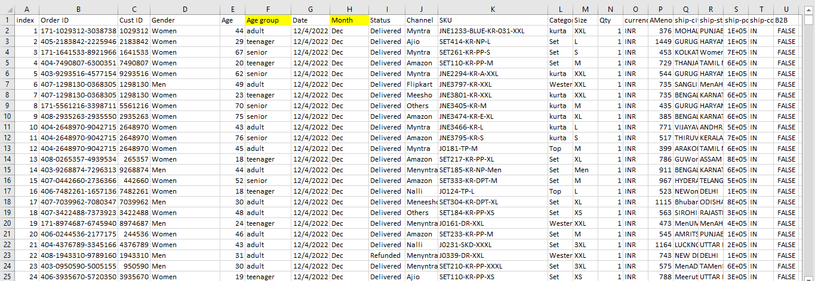
Content of Data Set

Slide 7
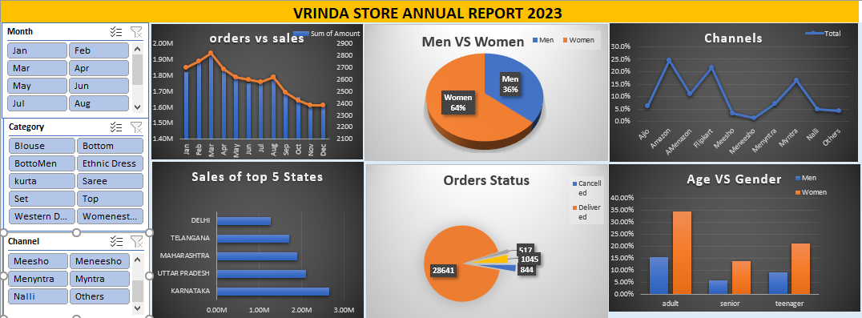
DASHBOARD

Slide 8
INSIGHTS
Women are more likely to buy compared to men (~65%)
Maharashtra, Karnataka and Uttar Pradesh are the top 3 states (~35%)
Adult age group (30-90 years) is max contributing (~50%)
Amazon, Flipkart and Myntra channels are max contributing (~80%)

Slide 9
CONCLUSION
Final Conclusion To Improve Vrinda Store Sales
Target women customers of age group (30-40 years) living in Maharashtra, Karnataka and Uttar Pradesh by showing Ads/Offers/Coupons available on Amazon, Flipkart and Myntra.

Slide 10
THANK YOU

